Slide 1
OPINION SURVEY: European Commissioner for animal welfare
European study
June 2024

Slide 2
Introduction
1

Slide 3
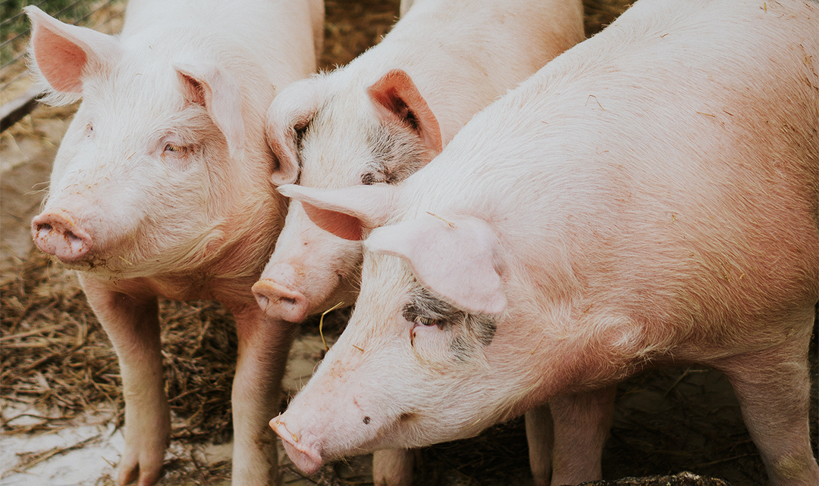
Background & Research Objectives
Background
Research Objectives
An EU commissioner is a member of the European Commission. Just like national ministers, each EU commissioner is assigned a topic on which he/she makes policy.
He/she does this by designing, proposing and implementing laws, taking into account the current policy and the available budget.
In this way, the topic is given the necessary attention and it is possible to draft rules that apply to the entire European Union.
At this moment, there is no European commissioner for Animal Welfare.
GAIA wants to know whether European citizens think that there should be a European commissioner for Animal Welfare.

Slide 4
Methodology
SAMPLE DESCRIPTION
DATA COLLECTION METHOD
Adults (18-65 y.o.) in the 10 largest EU countries
(covers 81% of EU population)
Online interviews on Ipsos panel
SAMPLE SIZE
AVG. INTERVIEW DURATION
n=3500 (n=300 - 400 per country depending on country size)
2 minutes
QUOTA
FIELDWORK PERIOD
For each country
Gender
Age
Region
June 2024

Slide 5
GEOGRAPHICAL SCOPE
The study is conducted in 10 countries
Belgium (n=300)
France (n=400)
Germany (n=400)
Hungary (n=300)
Italy (n=400)
Netherlands (n=300)
Poland (n=400)
Romania (n=300)
Spain (n=400)
Sweden (n=300)
Note: The data is weighted to the national representative figures of each country and to the population size of each country.
When looking at ‘European’ results, data is weighted according to the population size of the country.

Slide 6
REPRESENTATIVITY OF THE STUDY
In order to guarantee representative results in Europe, two weightings were applied.
1 | Within each country, respondents were weighted on age, gender and region to the respective national representative values.
2 | On European level, all countries are weighted to match their weight in terms of population.
COUNTRY | WEIGHT (in %)
Belgium | 3,22
France | 18,67
Germany | 23,11
Hungary | 2,63
Italy | 16,16
Netherlands | 4,88
Poland | 10,07
Romania | 5,22
Spain | 13,17
Sweden | 2,88
Source: Eurostat 2023

Slide 7
How to read the results
All reported results are percentages (%), unless indicated otherwise.
Low base sizes, i.e. n < 30, are indicated with an asterisk (*).
Significant differences are always tested for at the 95% confidence level.
Significant differences between groups are marked via A, B, C, …
Differences are always indicated with the highest result in the comparison.
E.g. the indication AC with group 2 denotes a significant difference between 70% (B) and 54% (A) and between 70% (B) and 58% (C).
AC
EXAMPLE
*Low base size!
This report is best viewed in PowerPoint 2013 or later.
In case you are experiencing issues with viewing content in an older version of PowerPoint, please notify your Ipsos contact person.

Slide 8
Results
2

Slide 9
EU Commissioner for animal welfare: Yes, or no?
2.1
2. RESULTS

Slide 10
AWARENESS European commissioner for animal welfare
The large majority of Europeans know that there is currently not a European commissioner for Animal Welfare.
79%
59
67
79
86
72
Of Europeans think there is no EU commissioner for Animal Welfare
82
77
85
85
74
○ | >85% think there is no commissioner for Animal Welfare
○ | 75-85% think there is no commissioner for Animal Welfare
○ | <75% think there is no commissioner for Animal Welfare
Base: Top 10 largest EU countries 2024 (n=3500)
Question: Q1. Of which of the following topics do you think the European Commission has a commissioner?

Slide 11
AWARENESS European commissioner for animal welfare
Within The Netherlands and Sweden, citizens most often think there is already a commissioner for Animal Welfare.
BELGIUM | FRANCE | GERMANY | HUNGARY | ITALY | NETHERLANDS | POLAND | ROMANIA | SPAIN | SWEDEN
J
J
J
AFIJ
AFJ
FJ
ACD
FIJ
ACD
FIJ
AD
FIJ
BCD
EGH
ABCDE
FGHI
BCE
GH
EG
EGH
BE
GH
○ | Europeans think there is no commissioner for Animal Welfare
○ | Europeans think there is a commissioner for Animal Welfare
Base: Top 10 largest EU countries 2024 (n=3500)
Question: Q1. Of which of the following topics do you think the European Commission has a commissioner?

Slide 12
Opinion about a European commissioner for animal welfare (WITHOUT “NO OPINION” OPTION)
7 out of 10 Europeans would say “Yes” to an EU commissioner for Animal Welfare.
“Do you think there should be a European commissioner for Animal Welfare?”
70%
84
Yes
68
69
61
63
68
70
75
70
30%
72
No
○ | >75% of Europeans think there should be an EU commissioner for Animal Welfare
○ | 65-75% of Europeans think there should be an EU commissioner for Animal Welfare
○ | <65% of Europeans think there should be an EU commissioner for Animal Welfare
Base: Top 10 largest EU countries 2024 (n=3500)
Question: Q2a. Do you think there should be a European commissioner for Animal Welfare?
Q2b. Assuming you have to choose, do you think there should be a European commissioner for Animal Welfare?

Slide 13
Opinion about a European commissioner for animal welfare (WITHOUT “NO OPINION” OPTION)
In all countries, the majority of citizens think there should be a European commissioner for Animal Welfare. The support is the highest amongst citizens of Italy and Sweden.
BELGIUM | FRANCE | GERMANY | HUNGARY | ITALY | NETHERLANDS | POLAND | ROMANIA | SPAIN | SWEDEN
G
G
AG
G
G
AG
ABG
ABCD
EFGHI
DEIJ
EJ
J
J
BCDE
FHIJ
J
J
J
J
○ | Yes
○ | No
Base: Top 10 largest EU countries 2024 (n=3500)
Question: Q2a. Do you think there should be a European commissioner for Animal Welfare?
Q2b. Assuming you have to choose, do you think there should be a European commissioner for Animal Welfare?

Slide 14
Opinion about a European commissioner for animal WELFARE according to age and gender (WITHOUT “NO OPINION” OPTION)
The idea of a European commissioner is significantly more supported by younger Europeans (18-34 y.o.) and women.
“Do you think there should be a European commissioner for Animal Welfare?”
TOTAL | AGE |  |  | GENDER
 | 18 – 34 y.o. | 35 – 54 y.o. | 55+ y.o. | MEN | WOMEN
○ | Yes
○ | No
BC
D
A
A
E
Base: Top 10 largest EU countries 2024 (n=3500)
Question: Q2a. Do you think there should be a European commissioner for Animal Welfare?
Q2b. Assuming you have to choose, do you think there should be a European commissioner for Animal Welfare?

Slide 15
PRIORITY OF ANIMAL WELFARE
2.2
2. RESULTS

Slide 16
Opinion about a European commissioner for animal WELFARE, sports and cyber security
The support for a European Commissioner for cyber security and animal welfare is the highest. European citizens are less inclined to support a European Commissioner for Sports.
“Do you think there should be a European commissioner for … ?”
ANIMAL WELFARE | CYBER SECURITY | SPORTS
○ | Yes
○ | No
C
AC
AB
B
Base: Top 10 largest EU counties 2024 (n=3500)
Question: Q2a. Do you think there should be a European commissioner for Animal Welfare?
Q3a. Do you think there should be a European commissioner for Cyber Security?
Q4a. Do you think there should be a European commissioner for Sports?

Slide 17
Conclusions
3

Slide 18
Conclusions
1 | EU citizens are well aware that there isn’t currently an EU commissioner for Animal Welfare. In all European countries, the majority of citizens are aware that there is currently not an EU commissioner for Animal Welfare.
2 | The majority of the citizens is in favour of an EU commissioner in every country. Even though there is more support for an EU commissioner in one country compared to another country, in all countries more than 60% of the citizens support it. The support is highest amongst citizens from Sweden and Italy.
3 | The support for a European commissioner for Animal Welfare is higher amongst young Europeans (18-34 y.o.) and women.

Slide 19
Geert Francken
Jasper claes
Service Line Director
Research Manager
Geert.Francken@ipsos.com
Jasper.Claes@ipsos.com
+32 495 27 88 63
+32 479 87 51 77
Delfine Boone
Research Executive
Delfine.Boone@ipsos.com
+32 3 613 00 68

Slide 21
ABOUT IPSOS
GAME CHANGERS
Ipsos is the third largest market research company in the world, present in 90 markets and employing more than 18,000 people.
Our research professionals, analysts and scientists have built unique multi-specialist capabilities that provide powerful insights into the actions, opinions and motivations of citizens, consumers, patients, customers or employees. Our 75 business solutions are based on primary data coming from our surveys, social media monitoring, and qualitative or observational techniques.
“Game Changers” – our tagline – summarizes our ambition to help our 5,000 clients to navigate more easily in our deeply changing world.
Founded in France in 1975, Ipsos is listed on the Euronext Paris since July 1st, 1999. The company is part of the SBF 120 and the Mid-60 index and is eligible for the Deferred Settlement Service (SRD).
ISIN code FR0000073298, Reuters ISOS.PA,
Bloomberg IPS:FP
www.ipsos.com
In our world of rapid change, the need for reliable information to make confident decisions has never been greater.
At Ipsos we believe our clients need more than a data supplier, they need a partner who can produce accurate and relevant information and turn it into actionable truth.
This is why our passionately curious experts not only provide the most precise measurement, but shape it to provide True Understanding of Society, Markets and People.
To do this we use the best of science, technology and know-how and apply the principles of security, simplicity, speed and substance to everything we do.
So that our clients can act faster, smarter and bolder.
Ultimately, success comes down to a simple truth:
You act better when you are sure.

